Slide 1

CRICKET PLAYERS PERFORMANCE SYSTEM

Slide 2


MENTOR:
JAYAVIBHAVA
TEAM MEMBERS:
GOPAL DUBEY-137178
BANDARU SUSHMICA-137164
PULLE SAI KEERTHANA-137229
EROTHI ANITHA DEVI-137174
LANKA POOJA PRIYANKA -137189

Slide 3
INTRODUCTION
This project is aimed at developing Cricket Players Performance System(CPPS)
The system will be used to check the performance of cricketer’s of different countries in various types of International matches .
TECHNOLOGY USED
What
And
Why
ORACLE 11G DATABASE
Informatica Power Center 9.6.1(ETL TOOL)
COGNOS

Slide 4
DATA WAREHOUSE
A Data warehouse is a relational database that is designed for query and analysis rather than for transaction processing.
A Datawarehouse is designed to support business decisions by allowing data consolidation, analysis and reporting at different aggregate levels.
CHARACTERISTICS OF DATA WAREHOUSE
Subject Oriented
Integrated
Time Variant
Non Volatile

Slide 5
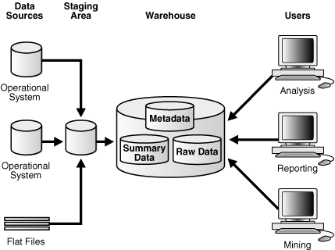
DATA WAREHOUSE ARCHITECTURE

Slide 6
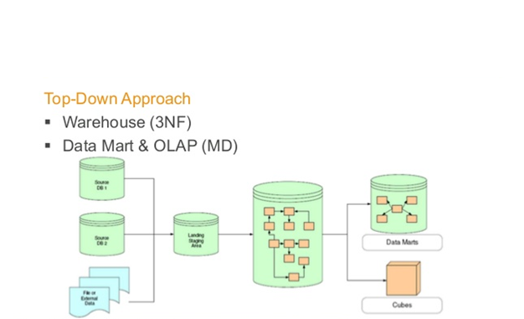
DATA WAREHOUSING STRATEGY
Bill Inmon’s Top Down Approach
The data flow in the top down approach begins with data extraction from operational data sources.
The data marts are treated as subsets of data warehouse.
The data is loaded into staging area validated and consolidated.
This data from the staging is then loaded into data warehouse.

Slide 7
PROJECT FLOW
Flat Files
Staging
Extracting
Transforming
Loading
Data Warehouse
Cognos
Reporting

Slide 8
STAGING PHASE
In this phase, there is a need to clean and process operational data before
putting into the warehouse.
Often used as an intermediate step between data extraction and later steps.
Accumulates data from asynchronous sources using native interfaces, flat files, FTP sessions or other processes.
There is usually no end user access to the staging file.
An operational data store may be used for data staging.

Slide 9
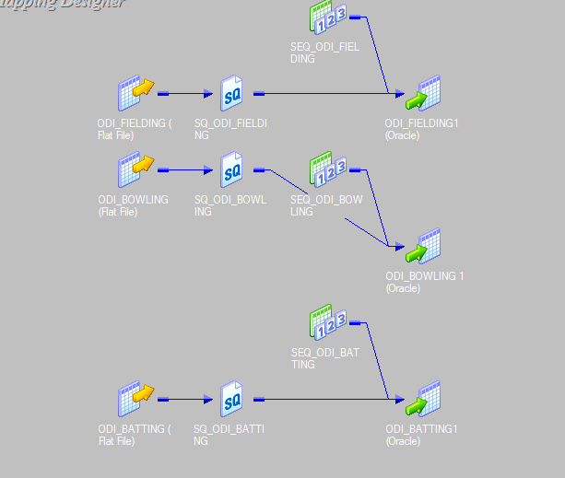
ODI STAGING

Slide 10
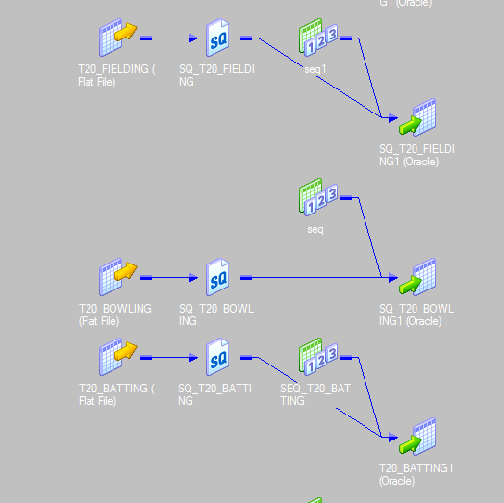
T20 STAGING

Slide 11
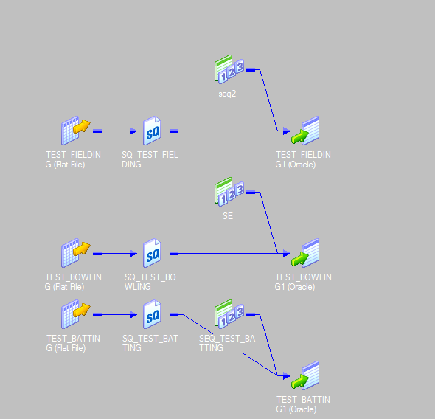
TEST STAGING

Slide 12
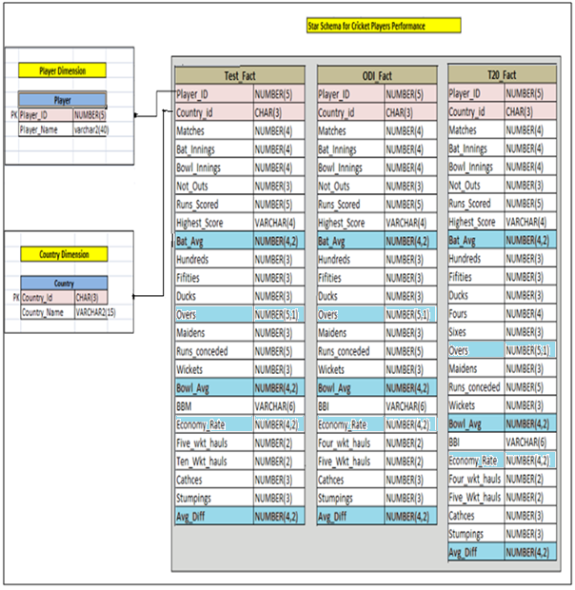

Slide 13
STAR SCHEMA
The Star Schema is perhaps the simplest data warehouse schema.
It is called as Star Schema because the entity relationship diagram of this schema resembles a star with points radiating from a central table.
The center of star consists of a large fact table and the points of the star are dimension tables.
A dimension contains reference information about the fact such as player and country.

Slide 14
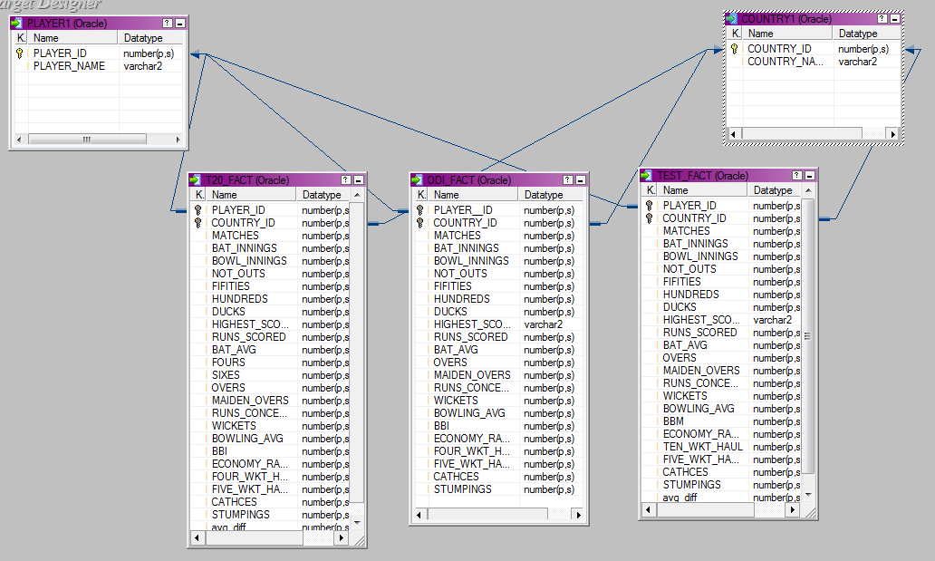

Slide 15
DIMENSION TABLE
A dimension table is a table in a star schema of a data warehouse.
A dimension table stores attributes, or dimensions, that describe the objects in fact table.
The fact table contains business facts(or measures), and foreign keys which refer to candidate keys(normally primary keys)in the dimensions tables.
Dimension attributes should be:
Verbose(labels consisting of full words)
Complete(having no missing values)
Descriptive
Discretely valued(having only one value per dimension table row)
Quality assured(having no misspellings or impossible values)

Slide 16
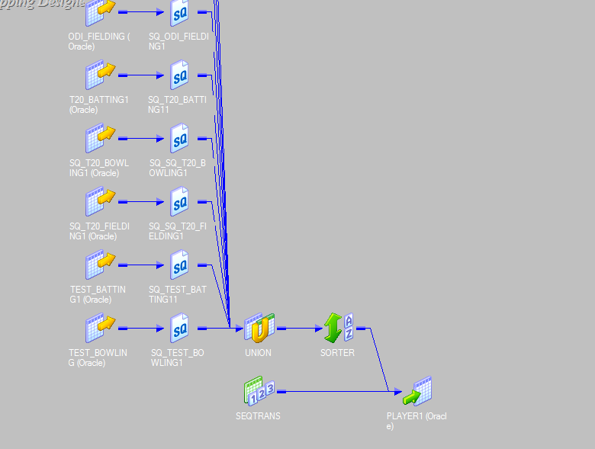
PLAYER DIMENSION

Slide 17
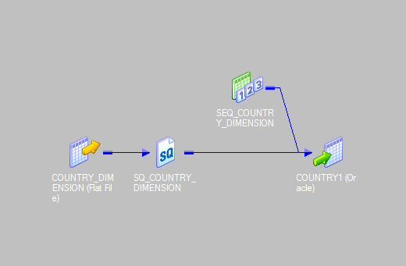
COUNTRY DIMENSION

Slide 18
FACT TABLE
A fact table consists of the measurements , metrics or facts of a business
process.
It is located at the center of a star schema or a snowflake schema
surrounded by dimension tables.
A fact table has typically two types of columns: those that contain facts
and those that are a foreign key to dimension tables.
The primary key of a fact table is usually a composite key that is made up of all of its foreign keys.

Slide 19
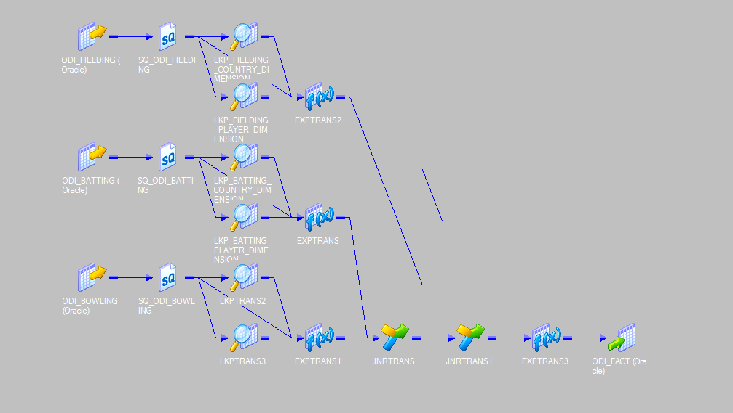
ODI FACT

Slide 20
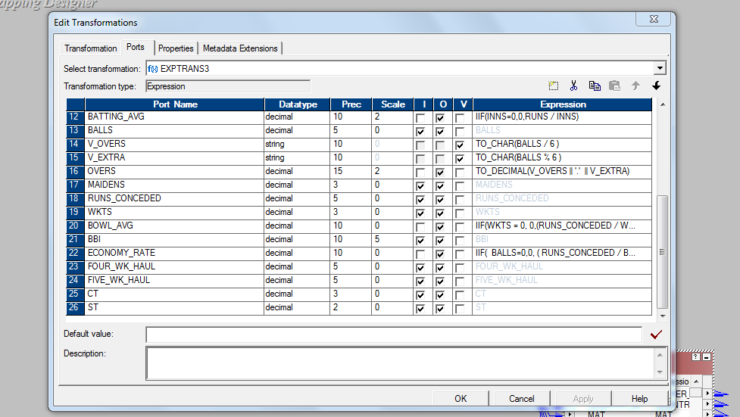

Slide 21
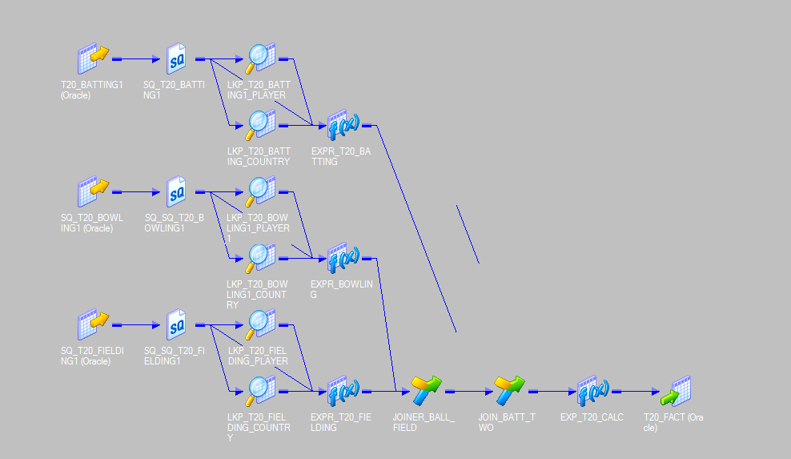
T20 FACT

Slide 22
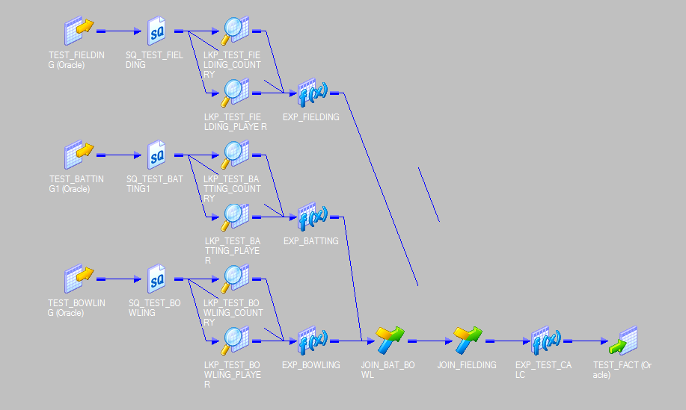
TEST FACT

Slide 23
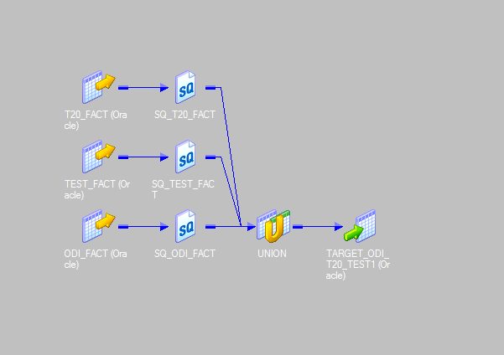
CPPS FACT

Slide 24
COGNOS
IBM COGNOS Business Intelligence is a Web based, integrated business intelligence suite by IBM.
It provides a tool set for reporting, analysis, scorecarding and monitoring of events and metrics.
The software consists of several components to meet the different information requirements in a company.

Slide 25
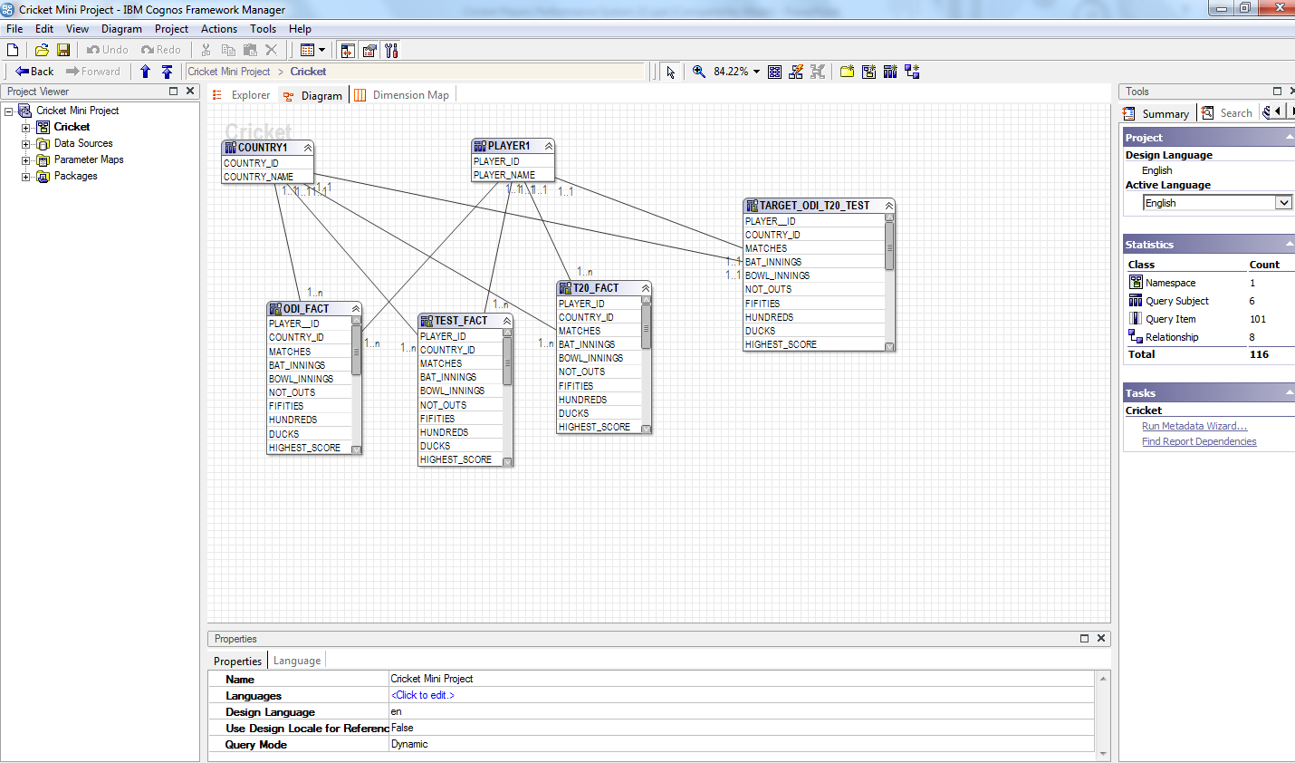

Slide 26
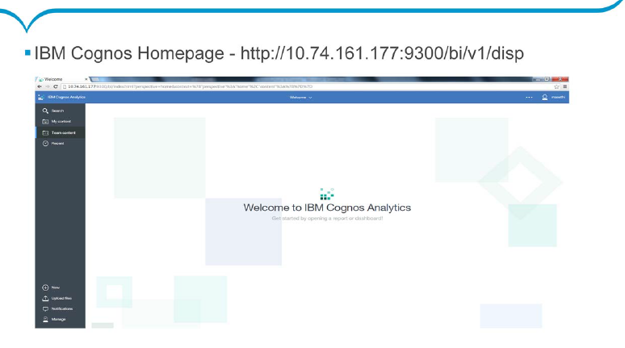

Slide 27
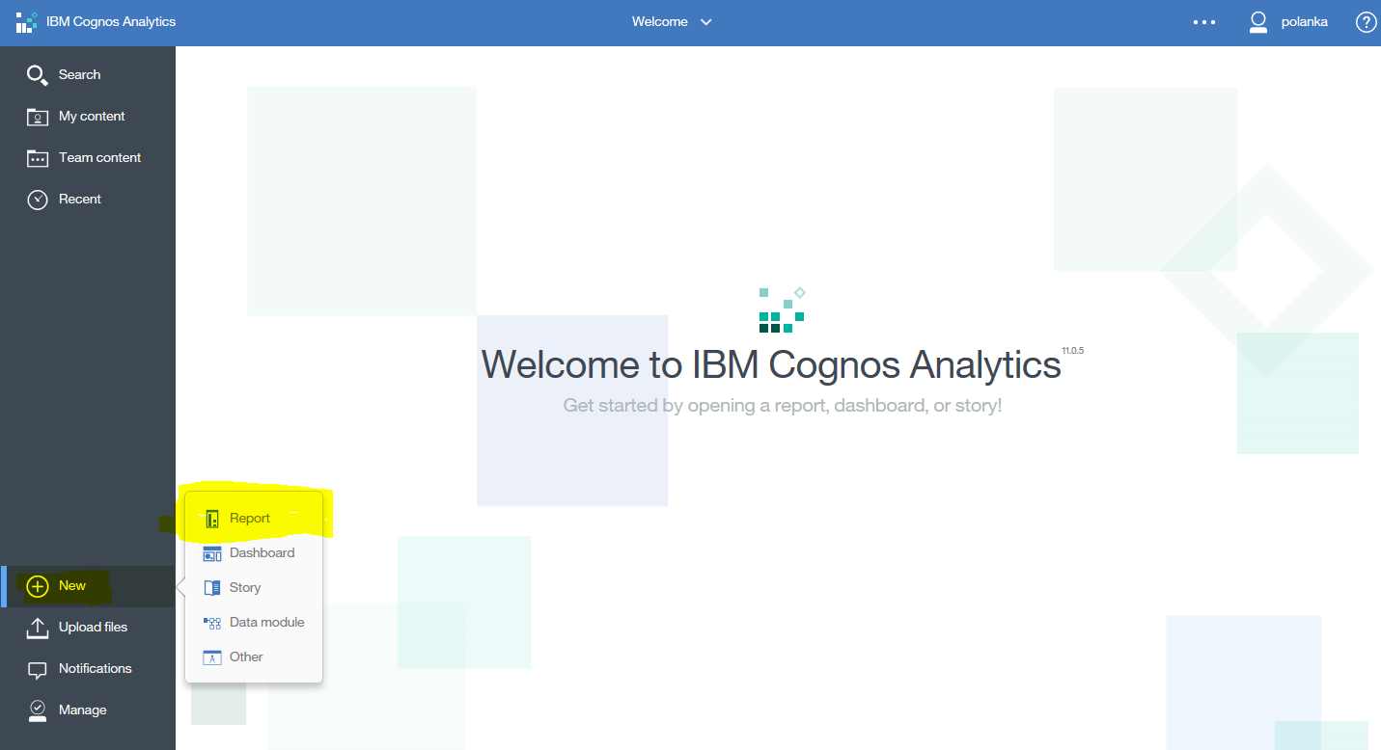
CREATING NEW REPORT

Slide 28
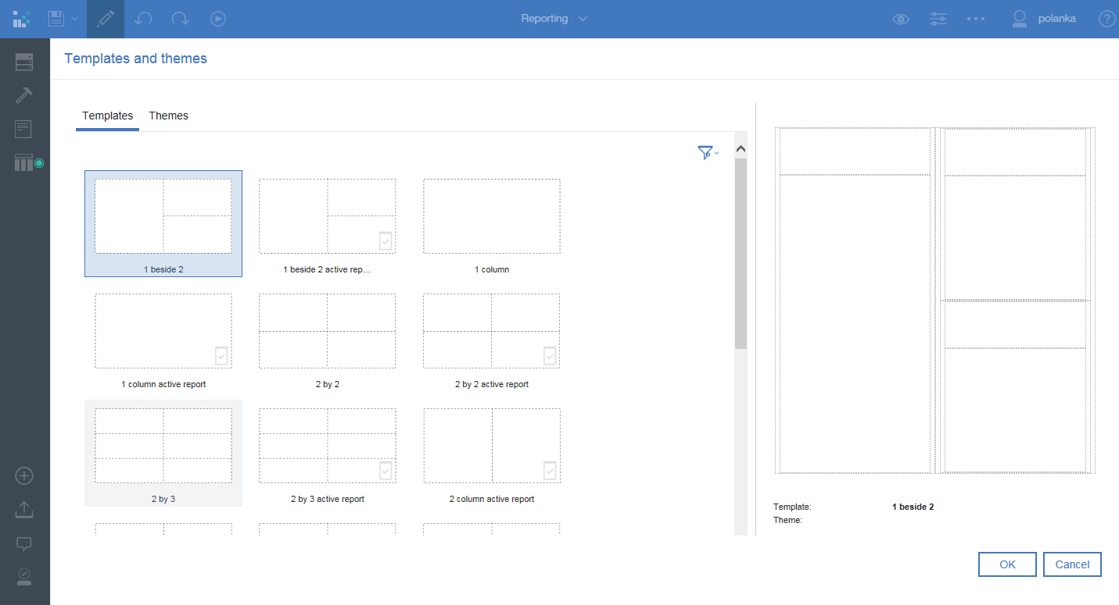

Slide 29
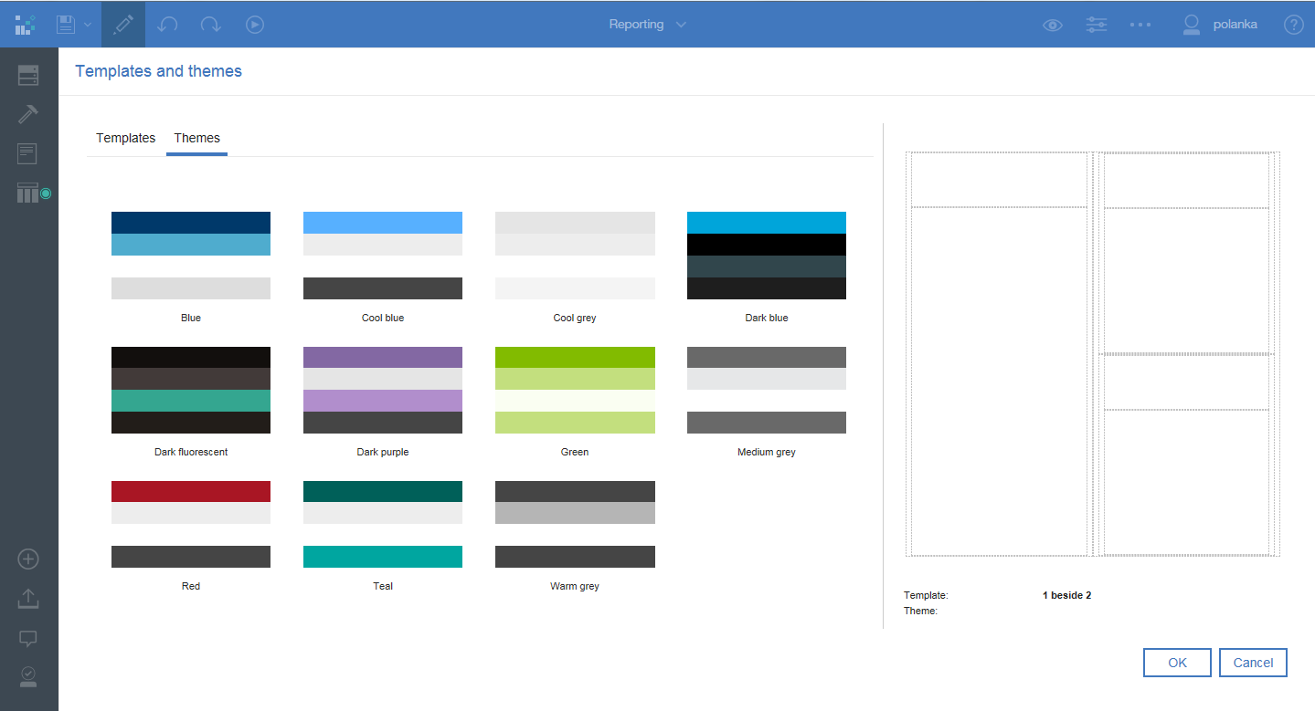

Slide 30
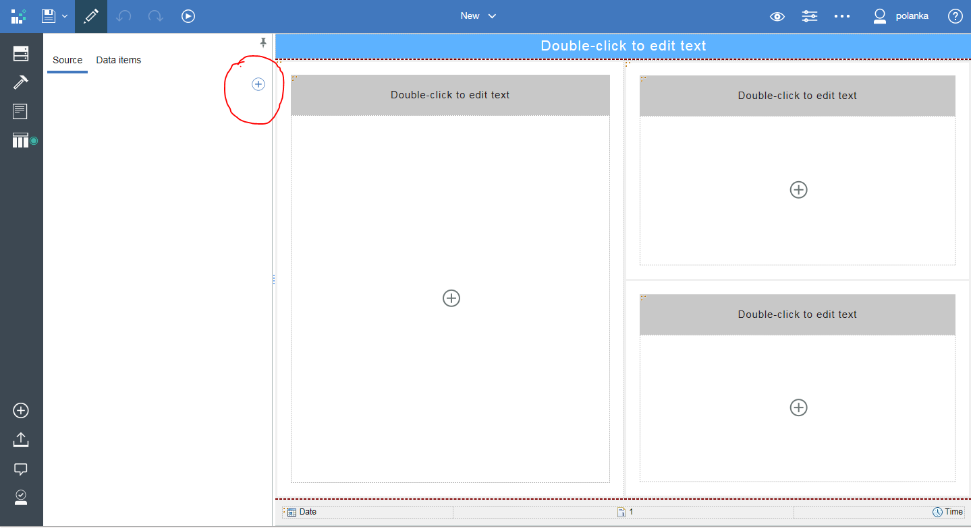

Slide 31
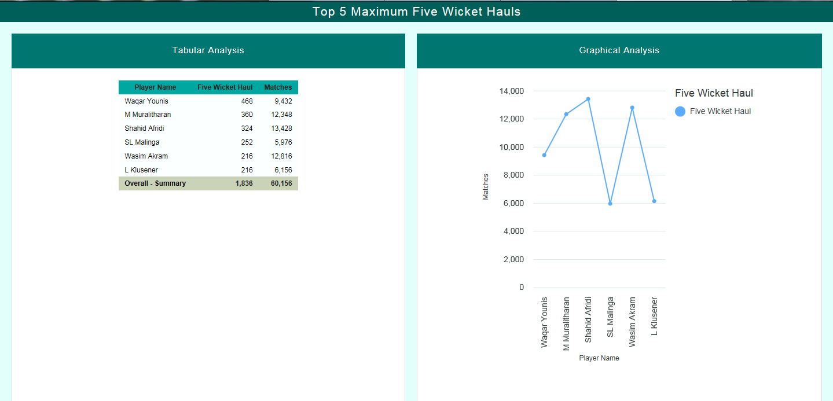
TOP 5 FIVE WICKET HAULS IN ODI

Slide 32
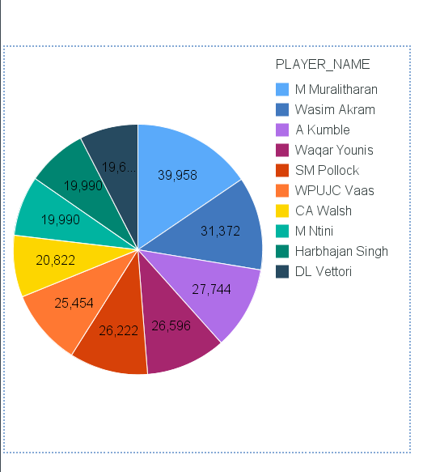
TOP 10 WICKET TAKERS IN TEST

Slide 33
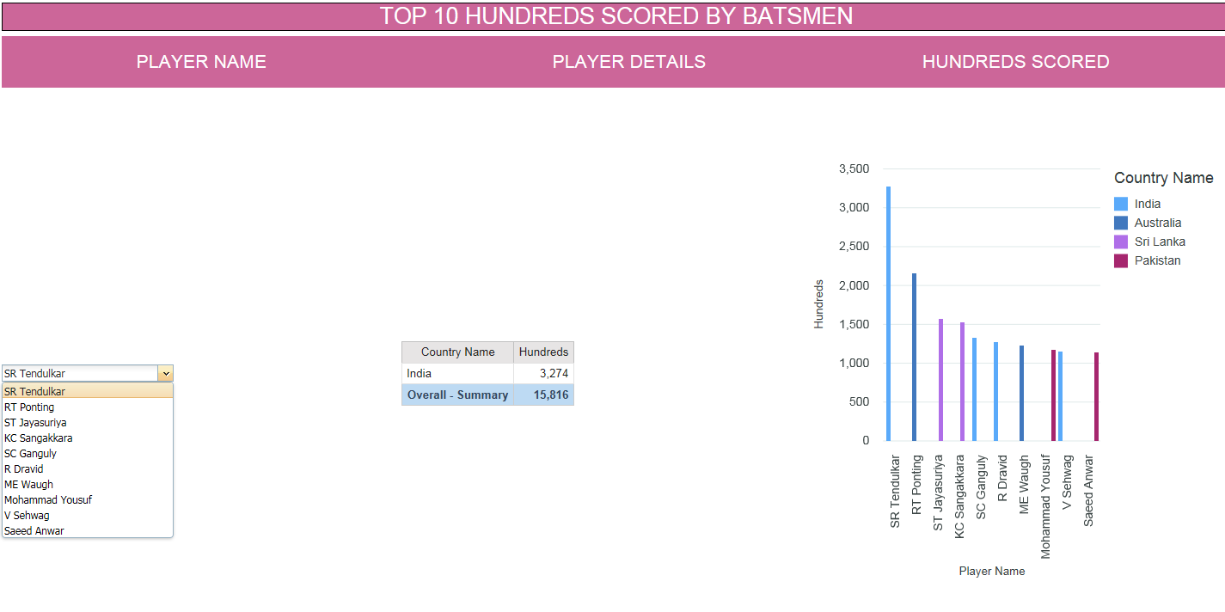
TOP 10 HUNDREDS SCORED

Slide 34
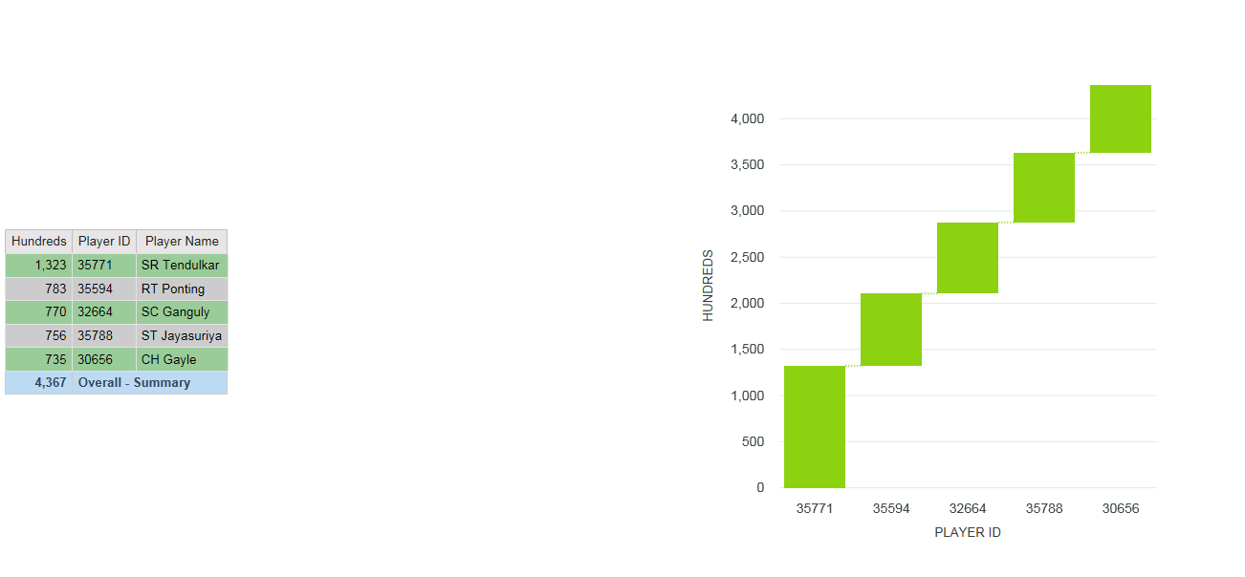
TOP 5 HUNDREDS IN ODI

Slide 35
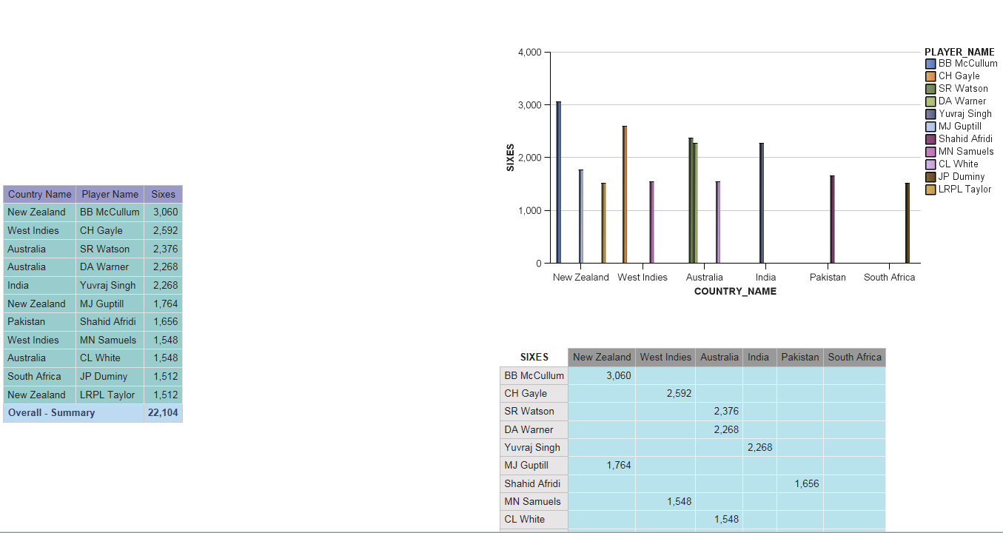
TOP 10 SIXES IN T20

Slide 36
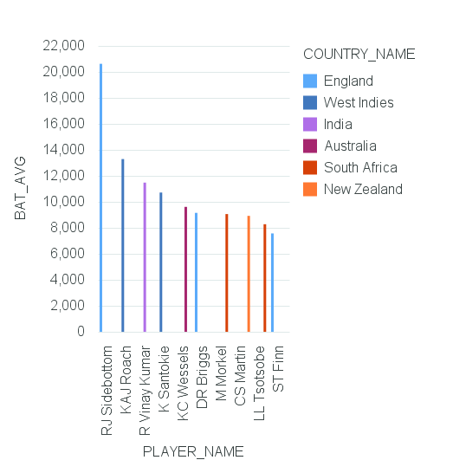
TOP 10 BATTING AVERAGE

Slide 37
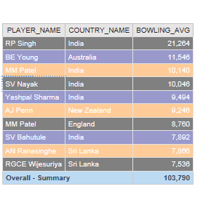
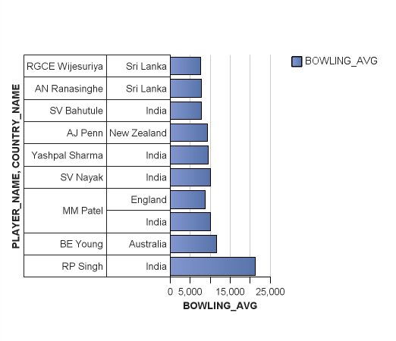
TOP 10 BOWLING AVERAGE

Slide 38
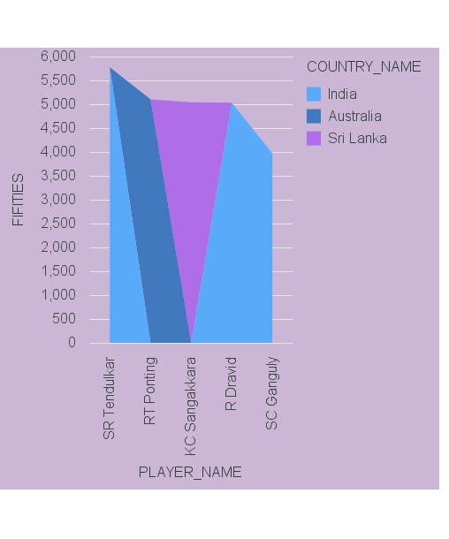
TOP 5 FIFTIES

Slide 39
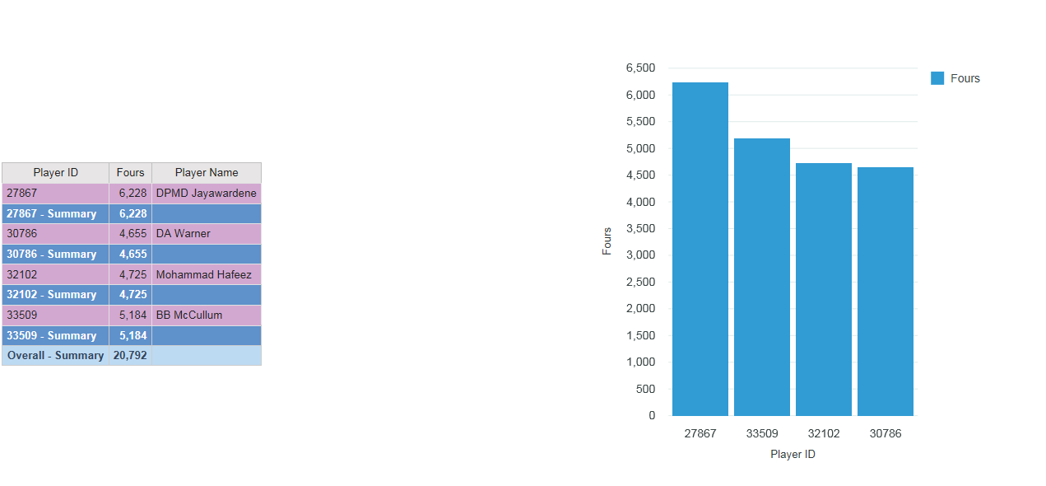
TOP 4 FOURS IN T20

Slide 40
Conclusion
We analyzed the Players on the basis of top batting/bowling and fielding parameters.
This project can be expanded by including additional domains in Cricket and can be used in future at very complex levels.
There is always a scope of Improvement.

Slide 41
THANK YOU

